Slide 1
RATINGS Review prediction
Yashna shah

Slide 2
Problem Statement
We have a client who has a website where people write different reviews for technical products. Now they are adding a new feature to their website i.e. The reviewer will have to add stars(rating) as well with the review. The rating is out 5 stars and it only has 5 options available 1 star, 2 stars, 3 stars, 4 stars, 5 stars. Now they want to predict ratings for the reviews which were written in the past and they don’t have a rating. So, we have to build an application which can predict the rating by seeing the review

Slide 3
introduction
Internet has revolutionized the way of shopping. Now we can do shopping seating at our home just by few clicks. The ecommerce industry is growing rapidly by extending its reach to almost every corner of the world. So there are plenty of online marketing websites available. This leads to confusion in our mind from where we can get the best products. Rating prediction is a well-known recommendation task aiming to predict user’s rating for those items which were not rated yet by customers. Predictions are computed from users’ explicit feedback.

Slide 4
Review of literature
Rating is a classification or ranking of someone or something based on a comparative assessment of their quality, standard or overall performance. Reviews and ratings play a very vital role in deciding the correct product. Nowadays, buyers can get the real idea of the products by reading the reviews given by other buyer on the websites. Everyday we come across various products in our lives, on the digital medium we swipe across hundreds of product choices under one category. It gets tedious for the customers to make selections.

Slide 5
Motivation for the problem solving
As we know, ratings can be easily sorted and judged whether the product is good or bad. But when it comes to reviews, we need to read through every line to make sure what the review conveys. Many product reviews are not accompanied by scale rating system, and are consisted only of textual evaluation. In this case , it becomes daunting and time consuming to compare different products in order to eventually make a choice between them. Therefore it is critically important to predict the user rating from the text review. Getting an overall sense of a text review could in turn improve consumer experience.
The goal of this project is to build an application which can predict the rating by seeing the review. In the long run, this would allow people to better explain and review their purchase with each other in this increasingly digital world.

Slide 6
Data science life cycle
Follow the complete life cycle of data science. Include all the steps like:
1. Data Cleaning
2. Exploratory Data Analysis
3. Data Preprocessing
4. Model Building
5. Model Evaluation
6. Selecting the best mode

Slide 7
Data pre- processing
The following pre-processing pipeline is required to be performed before building the classification model prediction:
1. Load dataset
2. There were no null values in our dataset.
3. Drop Unnamed:0 column as it was not useful.
4. Convert review text to lower case and replace '\n' with single space.
5. Keep only text data ie. a-z' and remove other data from comment text.
6. Remove stop words and punctuations
7. Apply Stemming
8. Convert text to vectors using TfidfVectorizer
9. Saving the mode

Slide 8
Tecnology used
Hardware technology being used.
RAM : 16 GB
CPU : 11th Gen Intel(R) Core(TM) i5-1135G7 @ 2.40GHz 2.42 GHz
GPU : intel Iris Graphics Software technology being used.
Programming language :
Python Distribution : Anaconda Navigator Browser based language shell : Jupyter Notebook
Libraries/Packages specifically being used.
Pandas, NumPy, matplotlib, seaborn, scikit-learn, NLTK

Slide 9
Problem solving approaches
1. I checked through the entire training dataset for any kind of missing values information and all these pre - processing steps were repeated on the testing dataset as well.
2. Then we went ahead and took a look at the dataset information. Using the info method, we are able to confirm the non-null count details as well as the datatype information.
3. Since there was no use of the "Unnamed:0" column I have dropped it.
4. Stemming is the process of reducing a word to its word stem that affixes to suffixes and prefixes or to the roots of words known as a lemma. Stemming is important in natural language understanding (NLU) and natural language processing (NLP)

Slide 10
Ml algorithms used
The complete list of all the algorithms used:
1) Logistic Regression
2) Random Forest Classifier
3) K Nearest Neighbors Classifier
4) Decision Tree Classifier

Slide 11
Key metrics used
The key metrics used here were accuracy score, cross validation score, classification report and confusion matrix. We tried to find out the best parameters and also to increase our scores by using Hyperparameter Tuning and we will be using GridSearchCV Method.

Slide 12
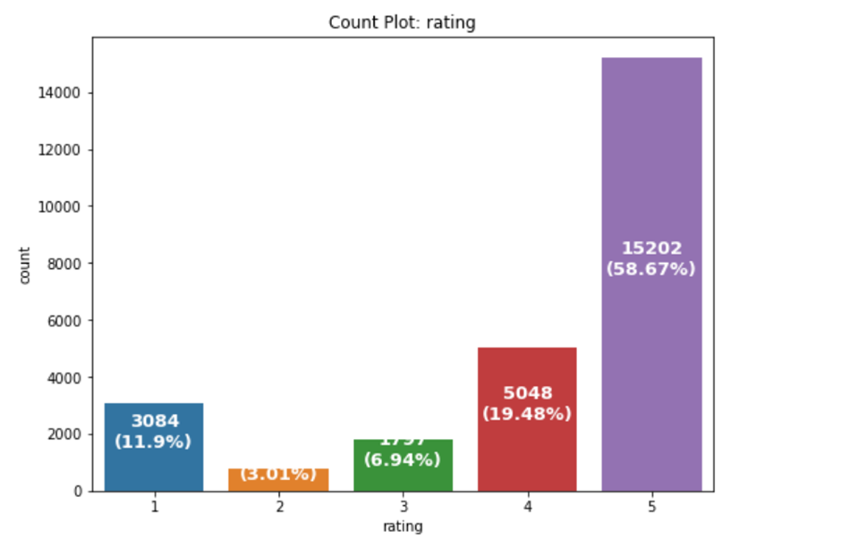
visualizations
1. Checking feature rating using count plot

Slide 13
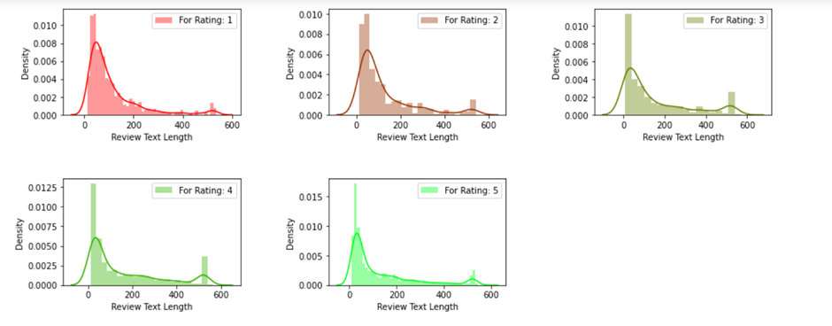
visualization
2. Checking review text length
distribution for each rating

Slide 14
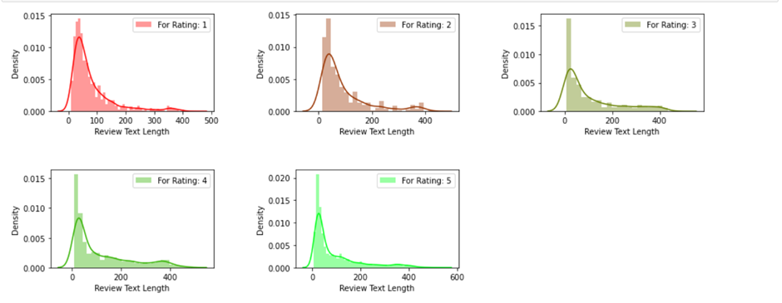
visualization
3 Checking review text length distribution
for each rating after cleaning

Slide 15
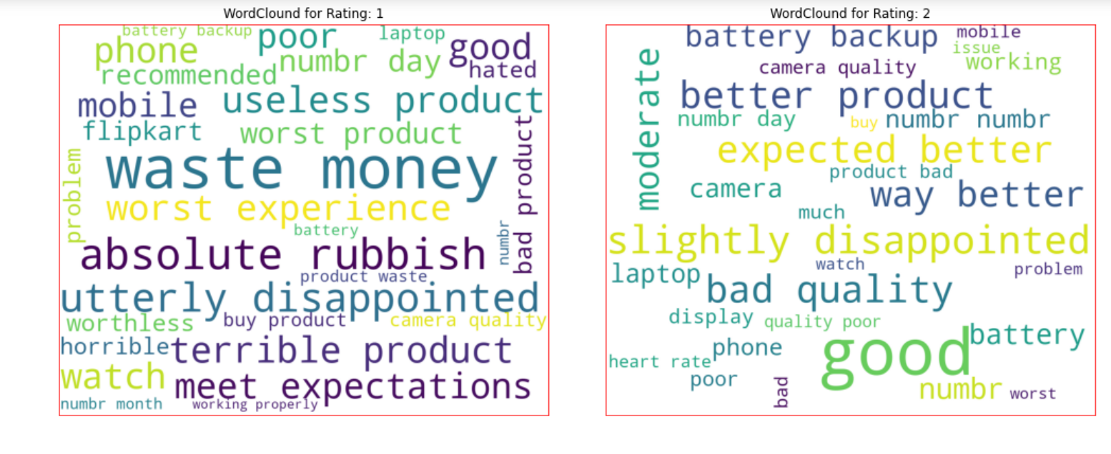
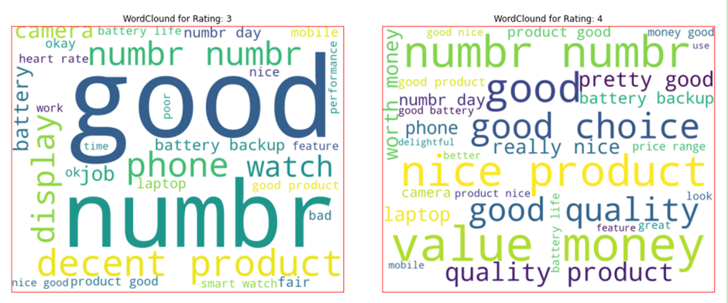
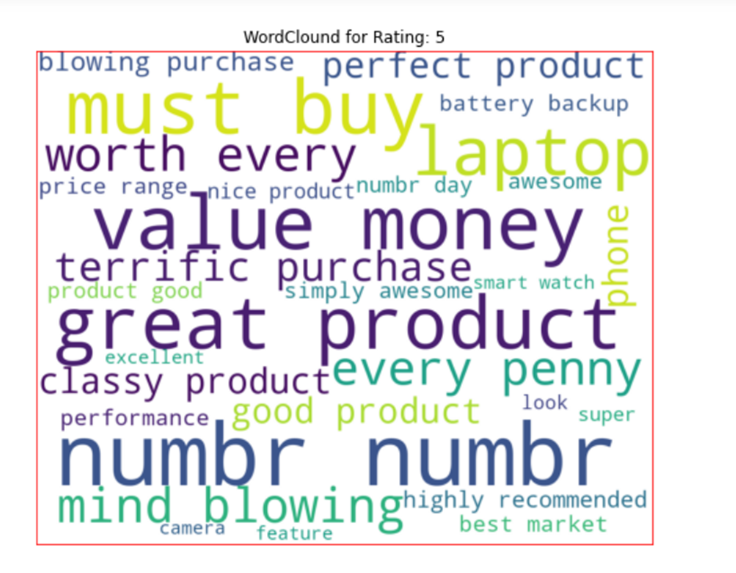
visualization
4. Word Cloud
getting sense of loud word in each rating

Slide 16
Interpretation
1. We can see that the highest number of customer rating received are for 5 star rating.
2. With word cloud it was found that rating 1 consists of words like waste money, worst experience,horrible, absolute rubbish etc; rating 2 consists of words like problem, issue, bad, poor, slow etc; rating 3 consists of words like average nice etc; rating 4 consists of words like really nice, good choice, good value etc; rating 5 consists of words like mind blowing, best market, good product, excellent etc.
It was evident that the length of review text decreases by a large amount after removal and replacement of certain items like punctuations, extra spaces, money symbols with the help of distribution plots.

Slide 17
conclusion
This research evaluated that the rating of a product classification using machine learning and NLP techniques. We compared the various machine learning algorithms accuracy by performing detailed experimental analysis while classifying the text into 5 categories.
RandomForest Classifier have shown a better performance with our real life data than others and the most performing models are all ensemble classifiers.
We found that the minimum difference between the accuracy score and the cross validation score is for RandomForest apart from Logical Regression. So the best fit model for our project is Random Forest Classifier.

Slide 18
Learning Outcomes of the Study
Through this project we were able to learn various Natural language processing techniques like lemmatization, stemming, removal of stopwords. We were also able to learn to convert strings into vectors through hash vectorizer. In this project we applied different evaluation metrics like log loss, hamming loss besides accuracy.

Slide 19
Thank you
Yashna shah

